Slide 1
BCSE203E - Web Programming
Dr. Leninisha
Asso Prof, SCOPE

Slide 2
World Wide Web and Its Evolution
The World Wide Web (WWW), commonly referred to as the Web, is a system of interlinked hypertext documents and multimedia content accessible via the Internet.
It was invented by Tim Berners-Lee in 1989 while working at CERN.
Since its inception, the Web has undergone significant evolution, categorized into phases often referred to as Web 1.0, Web 2.0, and Web 3.0, with emerging concepts of Web 4.0.

Slide 3
World's first website
The world's first website was hosted at CERN and was dedicated to the World Wide Web project:
Address: The first website's address was https://info.cern.ch/hypertext/WWW/TheProject.html
Creator: British computer scientist Tim Berners-Lee created the website in 1991
Purpose: The website was created to share information between scientists at universities and institutes around the world
Content: The website included information about the World Wide Web project, instructions on how to create web pages, and information about hypertext

Slide 4
Web 1.0 (1989–2000): The Static Web
Characteristics: Primarily static, read-only content.
Limited interactivity; websites were informational and non-dynamic.
HTML, HTTP, and URLs were foundational technologies.
Examples: Early websites like Britannica Online and static personal websites.
Drawbacks: Lack of user interaction and content contribution.
Limited multimedia capabilities.

Slide 5
The functionality of the WWW is based on 3 main standards:
URL (Universal Resource Locator)
HTML (Hypertext Markup Language)
HTTP (Hypertext transfer Protocol)

Slide 6
Uniform Resource Locator (URL)
URI stands for ‘Uniform Resource Identifier’.
A URI can be a name, locator, or both for an online resource whereas a URL is just the locator.
URLs are a subset of URIs.
A URL is a human-readable text that was designed to replace the numbers (IP addresses) that computers use to communicate with servers.
A URL consists of a protocol, domain name, and path (which includes the specific subfolder structure where a page is located) like-
protocol://WebSiteName.topLevelDomain/path
Protocol – HTTP or HTTPS.
WebSiteName – geeksforgeeks, google etc.
topLevelDomain- .com, .edu, .in etc.
path- specific folders and/or subfolders that are on a given website.

Slide 7
The Universal Resource Locator (URL)
Each page of information on the web has a unique address called the URL at which it can be found
http://faculty.uscupstate.edu/atzacheva/lecture1.html
The document can be obtained using the Hypertext Transfer Protocol (HTTP)
Host Name - The Name of Web Server
Path to the Web Page
File Name
Denotes that the File is Written in HTML
HyperText Markup Language
1
2
3
Protocol
Host Name
File Name

Slide 8
Uniform Resource Locator (URL)
Unique resource location in WWW, e.g.
It is just a formatted string, consisting of:
Protocol for communicating with the server (e.g., http, ftp, https, ...)
Name of the server or IP address + optional port (e.g. www.telerik.com, mail.bg:8080)
Path and name of the resource (e.g. index.php)
Parameters (optional, e.g. ?id=27&lang=en)
http://www.telerik.com/academy/winter-2009-2010.aspx

Slide 9
INTERNET/INTRANET/EXTRANET
Internet | Intranet | Extranet
A global network which is available to anyone who wants to access information | An intranet is unique to an organization or group of people who work together at a place | Extranet is for individuals or group of personnel who want to send private information
Privacy
Public | Private intermediately | Extremely Private
Dependency
Independent | Independent yet dependent on internet | Dependent on internet and intranet
Firewall
No | Can have | Yes

Slide 10
URI
URI’s are of two types:
Uniform Resource Name (URN)
Can be used to identify resources with unique names, such as books (which have unique ISBN’s)
Scheme is urn
Uniform Resource Locator (URL)
Specifies location at which a resource can be found
In addition to http, some other URL schemes are https, ftp, mailto, and file

Slide 11
HTTP Request (Cont…)
Common request methods:
GET
Used if link is clicked or address typed in browser
No body in request with GET method
POST
Used when submit button is clicked on a form
Form information contained in body of request
HEAD
Requests that only header fields (no body) be returned in the response

Slide 12
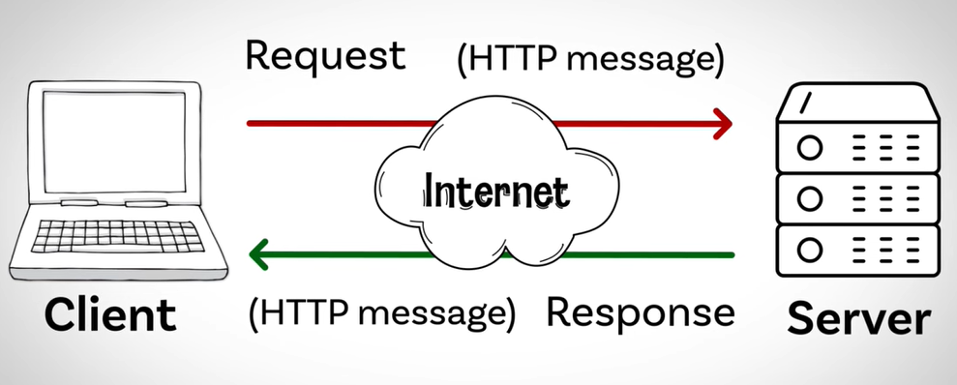

Slide 13
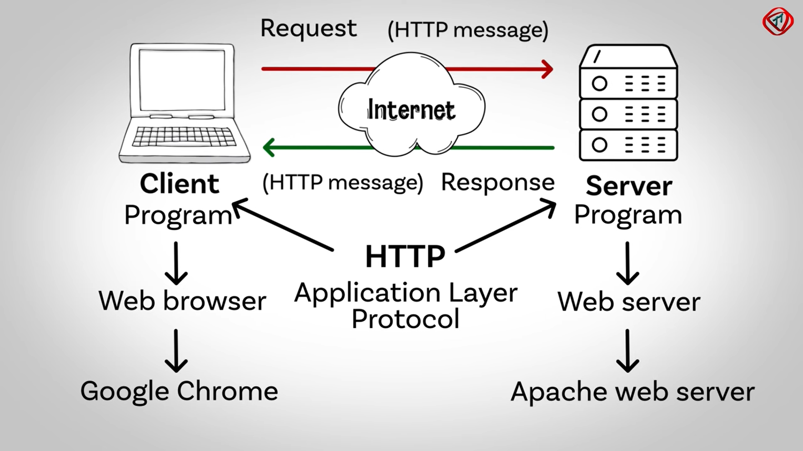

Slide 14
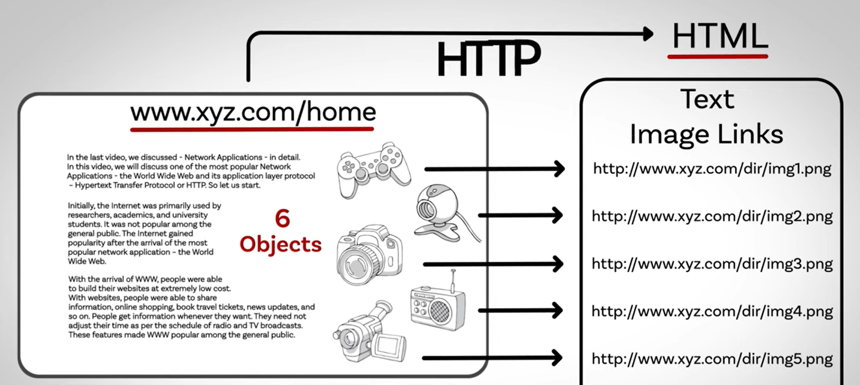

Slide 15
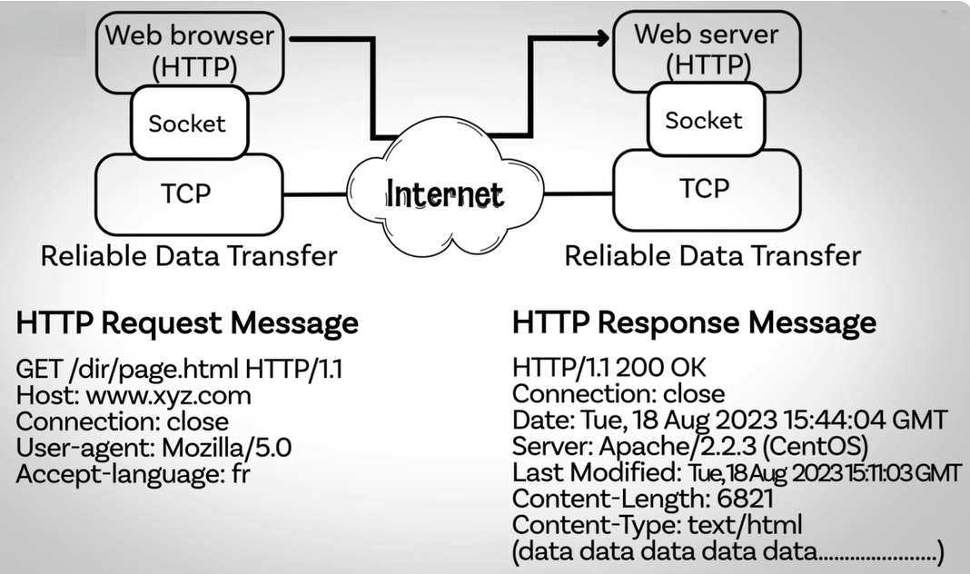

Slide 16
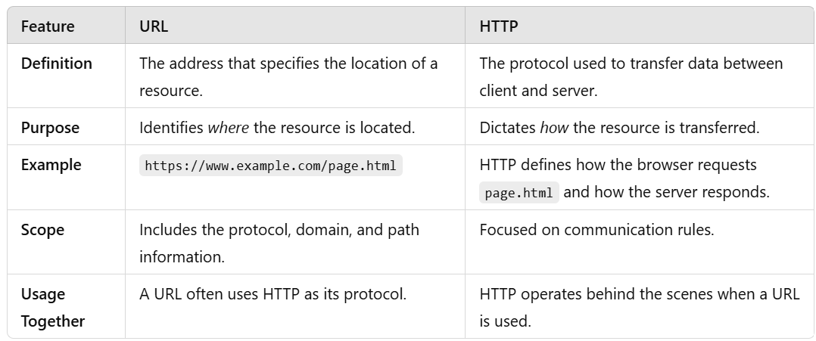
URL vs HTTP

Slide 17
Web 2.0 (2000–2010): The Social and Interactive Web
Characteristics: Shift towards user-generated content and interactivity.
Technologies like JavaScript, AJAX, and APIs enabled dynamic content.
Social networking sites, blogs, and collaborative platforms emerged (e.g., Facebook, YouTube, Wikipedia).
Emphasis on participatory culture: users could create, share, and interact with content.
Examples: Social media platforms, forums, and e-commerce sites like Amazon.
Cloud-based services like Google Drive and Dropbox emerged, enabling collaboration and storage in real-time.
Impact: Democratization of content creation.
Boost in global connectivity and online collaboration.

Slide 18
Web 3.0 (2010–Present): The Semantic and Decentralized Web
Characteristics: Focus on machine-readable data and the Semantic Web for smarter search and automation.
Incorporation of AI, machine learning, and natural language processing.
Interoperability and personalized user experiences.
Examples: AI-driven assistants like Siri and Alexa.

Slide 19
Web 3.0 (2010–Present): The Semantic and Decentralized Web
The focus on machine-readable data and the Semantic Web in Web 3.0 represents a transformative approach to how data is structured, accessed, and used.
Machine-readable data is information formatted in a way that computers can easily process and interpret without human intervention.
Examples include structured data formats like JSON, XML.
This advancement aims to make the Web more intelligent, enabling machines to process and understand information like humans, thereby facilitating smarter search, automation, and interoperability.

Slide 20
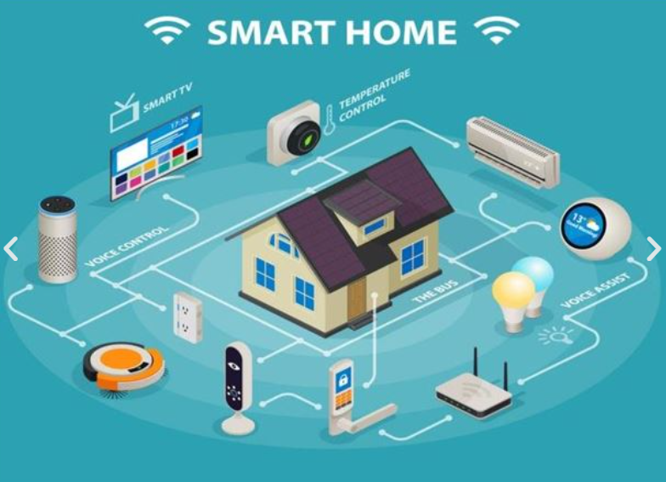
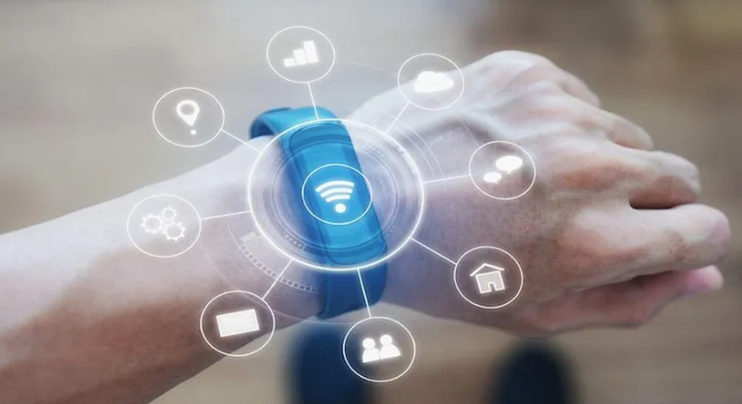
Web 4.0 (Emerging): The Intelligent and Ubiquitous Web

Slide 21

Web 4.0 (Emerging): The Intelligent and Ubiquitous Web

Slide 22
Web 4.0 (Emerging): The Intelligent and Ubiquitous Web
Characteristics: Integrates AI and IoT (Internet of Things) for a seamless user experience.
Predictive capabilities and real-time personalized interactions (Product Recommendations, Content Recommendations, Live Chat Assistance).
Immersive technologies like augmented reality (AR) and virtual reality (VR).
Goal of creating an interconnected, "everywhere" Web experience.
Examples: Smart homes, wearable technology, and AR/VR-based applications.

Slide 23
Is HTML run by an interpreter or a compiler?
HTML (HyperText Markup Language) is not run by either an interpreter or a compiler in the traditional sense, because it's not a programming language.
Instead, it is a markup language that is parsed by a web browser.
When a browser receives an HTML file, it reads the code line-by-line. The browser parses the HTML and builds the DOM (Document Object Model), which is a structured representation of the page's content.

Slide 24
Email
Email, short for electronic mail, is a method of exchanging digital messages over the internet.
Key Components of Email:
Sender: The person or system sending the email.
Recipient(s): The intended receiver(s) of the email, identified by their email address(es).
Email Address: A unique identifier for email users, typically structured as username@domain.com.
Subject: A brief summary or title of the email's content.
Body: The main content or message of the email, which can include text, images, and links.
Attachments: Files such as documents, images, or videos that can be sent along with the email

Slide 25
Email
How Email Works:
Composing: The sender writes the email and optionally attaches files.
Sending: The email is sent via an email client (like Gmail, Outlook, or Thunderbird) to an outgoing mail server (SMTP).
Routing: The mail server routes the email to the recipient's mail server using the Domain Name System (DNS) to locate it.
Receiving: The recipient's mail server stores the email in their inbox.
Retrieval: The recipient accesses the email using their email client.
Email Protocols:
SMTP (Simple Mail Transfer Protocol): Used to send emails.
IMAP (Internet Message Access Protocol) and POP3 (Post Office Protocol): Used to retrieve emails.

Slide 26
Email
Benefits of Email:
Speed: Instant delivery of messages across the globe.
Cost: Free or low-cost communication compared to traditional mail.
Convenience: Accessible from devices like smartphones, tablets, and computers.
Multimedia Support: Ability to include text, images, links, and attachments.
Archiving: Emails can be stored and searched for future reference.

Slide 27
Email
Use Cases:
Personal communication.
Business correspondence.
Marketing and advertising
Notifications and alerts (e.g., banking or e-commerce updates).

Slide 28
Telnet
Telnet is a network protocol and command-line utility used to establish a remote session to another computer or device over a TCP/IP network.
It provides a text-based communication interface to interact with remote systems as if you were using their local terminal.
Key Features of Telnet:
Remote Access: Allows users to log in to a remote computer and control it as if they were physically present.
Command-Line Interface: Operates through a text-based interface, enabling execution of commands directly.
Port Communication: Can connect to specific ports on a remote device to test services like web servers or troubleshoot connectivity.

Slide 29
Telnet
How Telnet Works:
Connection Establishment:
A user runs a Telnet client program on their computer.
The Telnet client connects to a Telnet server on the remote computer, typically over port 23 (default port for Telnet).
Authentication:
Once connected, the user is prompted to provide login credentials (username and password).
Interactive Session:
The user gains access to the remote system's command-line interface and can issue commands to perform various tasks (e.g., file management, network configuration).
Session Termination:
The session ends when the user logs out or disconnects from the Telnet server.

Slide 30
Telnet
Use Cases:
Network Diagnostics: Telnet can be used to troubleshoot network services by connecting to a specific IP address and port.
Remote Administration: Allows administrators to manage servers and devices remotely.
Testing Connectivity: Verifies that a specific service (e.g., a web server on port 80) is running and reachable.

Slide 31
Telnet
Disadvantages and Limitations:
No Encryption: Telnet transmits data, including passwords, in plain text, making it insecure for sensitive information.
Obsolete: Due to its lack of encryption, it has largely been replaced by secure protocols like SSH (Secure Shell)- which provides secure communication by encrypting the data.
Limited Functionality: Primarily suited for text-based interactions and lacks support for graphical interfaces.

Slide 32
File Transfer Protocol
FTP, or File Transfer Protocol, is a standard network protocol used to transfer files between a client and a server over a TCP/IP-based network, such as the Internet.
Key Features of FTP
File Transfer: FTP allows uploading files from a local computer to a server and downloading files from a server to a local computer.
User Authentication: Typically requires a username and password for access. Some FTP servers allow anonymous access (guest login without credentials).
File Permissions: Permissions can be set to control who can read, write, or execute files.

Slide 33
File Transfer Protocol
How FTP Works
Connection Establishment: The client connects to the server on port 21 (default FTP command port).
Authentication occurs if required.
Data Transfer: The client sends commands, and the server responds accordingly.
Data is transferred via a separate data connection (usually on port 20 or dynamically assigned ports in passive mode).

Slide 34
File Transfer Protocol
Common FTP Commands
get or mget: Download files from the server.
put or mput: Upload files to the server.
ls or dir: List files in a directory.
cd: Change directory.
delete: Remove a file.
quit: Exit the FTP session.
Use Cases
Website Management: Uploading and managing files for websites.
File Sharing: Sharing files between users on different systems.
Backup: Transferring backup files to remote servers.

Slide 35
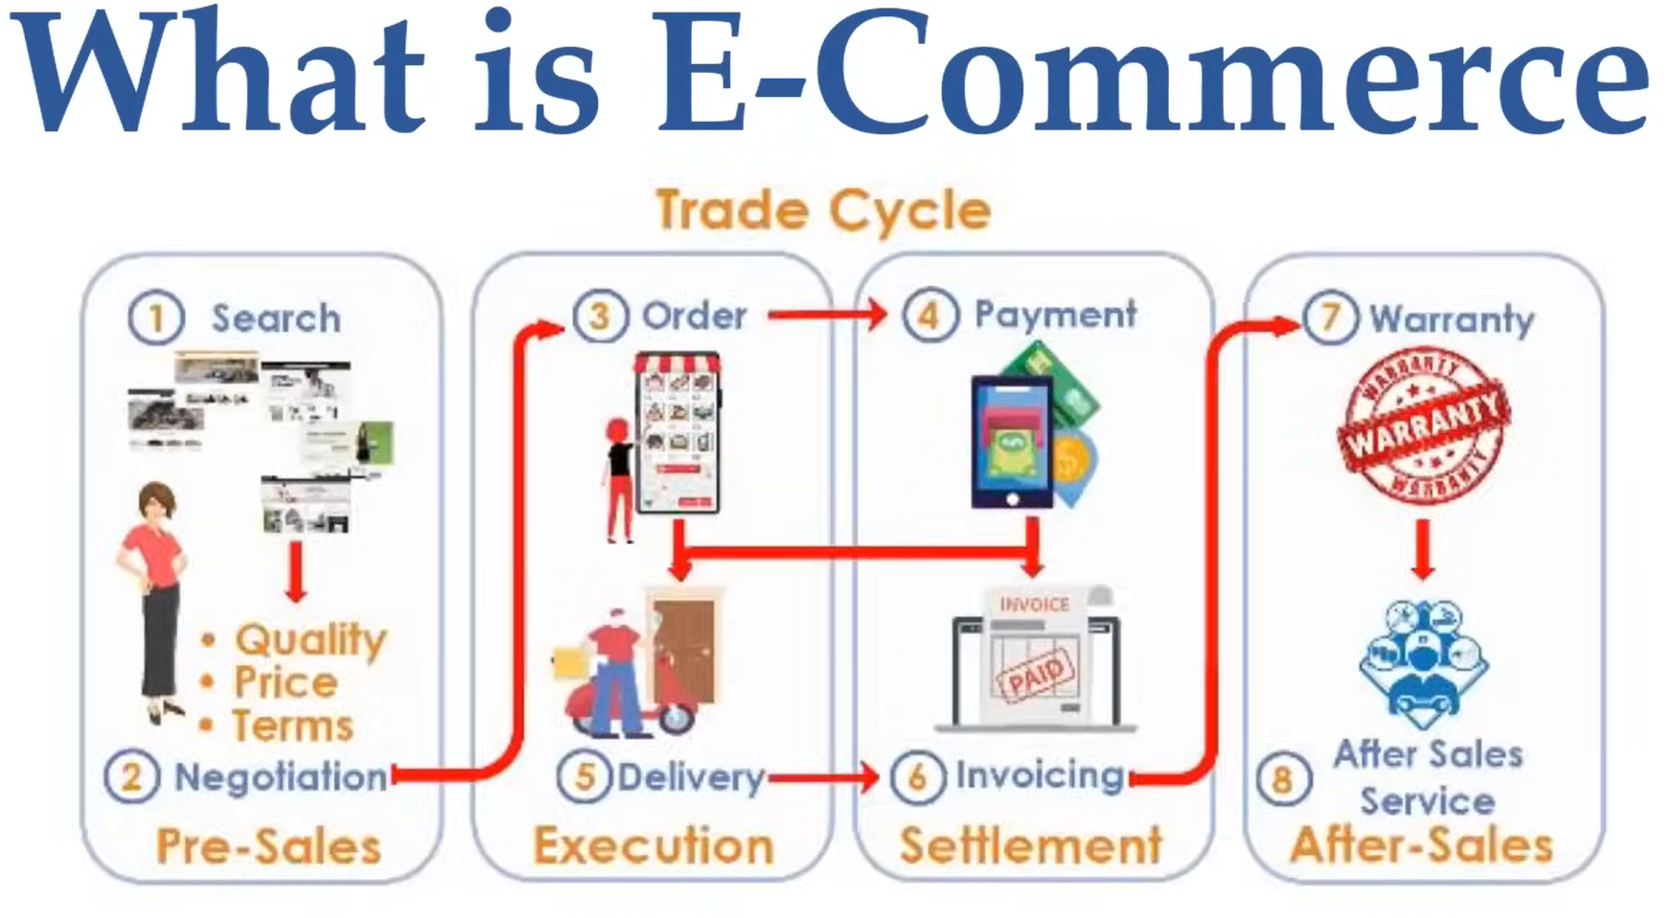

Slide 36
E-commerce
E-commerce (short for electronic commerce) refers to the buying and selling of goods and services over the internet.
Types of E-commerce Models
B2C (Business-to-Consumer):
Businesses sell products or services directly to individual consumers.
Example: Amazon, Flipkart.
B2B (Business-to-Business):
Transactions occur between businesses.
Example: Alibaba, software licensing between companies.
C2C (Consumer-to-Consumer):
Individuals sell goods or services to other individuals via a platform.
Example: eBay, OLX.

Slide 37
E-commerce
Types of E-commerce Models
C2B (Consumer-to-Business):
Consumers offer products or services to businesses.
Example: Freelancers offering services on platforms like Upwork.
D2C (Direct-to-Consumer):
Manufacturers or brands sell directly to consumers, bypassing intermediaries.
Example: Nike’s official website.
G2C (Government-to-Citizen):
Government services provided directly to citizens via online platforms.
Example: Online tax filing.

Slide 38
E-commerce
Key Features of E-commerce
Global Reach:
Businesses can reach customers across the world, breaking geographical barriers.
24/7 Availability:
E-commerce platforms operate round the clock, providing continuous service to customers.
Personalization:
Tailored recommendations based on user behavior and preferences using data analytics.
Cost Efficiency:
Reduces overhead costs associated with physical stores.
Convenience:
Customers can shop from anywhere using a device with an internet connection.

Slide 39
E-commerce
Advantages of E-commerce
Faster Buying Process: Customers can quickly browse, compare, and purchase products.
Wide Product Range: Offers access to a larger inventory than physical stores.
Enhanced Marketing: Digital tools like email marketing, social media ads, and search engine optimization improve visibility.
Data-Driven Insights: Businesses can analyze customer behavior to refine strategies.
Scalability: Easily adaptable to increasing customer demands

Slide 40
E-commerce
Challenges in E-commerce
Security: Protecting user data and transactions is crucial.
Logistics: Ensuring timely delivery, especially in remote areas.
Competition: Standing out in a crowded marketplace.
Customer Trust: Building credibility and ensuring product quality.
Technical Issues: Downtime or glitches can disrupt operations.

Slide 41
Cloud Computing
Cloud Computing refers to the delivery of computing services—such as servers, storage, databases, networking, software, analytics, and intelligence—over the internet (“the cloud”).
This model enables on-demand access to resources without the need for owning and maintaining physical data centers or servers.

Slide 42
Cloud Computing
Service Models in Cloud Computing
IaaS (Infrastructure as a Service):
Provides virtualized computing resources such as virtual machines, storage, and networks.
Example: Amazon Web Services (AWS) EC2, Microsoft Azure, Google Compute Engine.
PaaS (Platform as a Service):
Offers a platform allowing developers to build, test, and deploy applications without managing underlying infrastructure.
Example: AWS Elastic Beanstalk, Google App Engine, Microsoft Azure App Service.
SaaS (Software as a Service):Delivers software applications over the internet, accessible via web browsers.Example: Gmail, Dropbox, Salesforce.

Slide 43
Cloud Computing
Deployment Models in Cloud Computing
Public Cloud
Private Cloud
Hybrid Cloud
Advantages of Cloud Computing
Cost Efficiency
Scalability
Accessibility
Security

Slide 44
Video Conferencing
Key Components of Video Conferencing
Hardware:
Cameras: Capture live video of participants.
Microphones: Capture audio for clear communication.
Speakers or Headsets: Play audio from other participants.
Display Devices: Screens or monitors to view participants and shared content.
Computers/Devices: Serve as the platform for video conferencing software.

Slide 45
Video Conferencing
Key Components of Video Conferencing
Software:
Video conferencing applications like Zoom, Microsoft Teams, Google Meet, or Cisco Webex provide the platform for hosting and joining meetings.
Internet Connectivity:
A stable, high-speed internet connection is essential for smooth communication without lags or interruptions.

Slide 46
Video Conferencing
Common Features
Video and Audio Communication: Enables face-to-face communication from remote locations.
Screen Sharing: Share presentations, documents, or desktops during meetings.
Chat Functionality: Send text messages alongside video and audio.
Recording Options: Record meetings for later review.
Virtual Backgrounds: Customize or blur backgrounds to maintain privacy or enhance professionalism.
Breakout Rooms: Separate participants into smaller groups for discussions.
Scheduling and Integration: Sync with calendars and schedule meetings seamlessly.

Slide 47
Video Conferencing
Uses of Video Conferencing
Business Meetings: Connect with colleagues, clients, and stakeholders worldwide.
Education: Facilitate online classes, webinars, and student-teacher interactions.
Telemedicine: Enable remote consultations between doctors and patients.
Recruitment: Conduct virtual interviews to hire talent globally.
Personal Communication: Stay in touch with friends and family across distances.

Slide 48
Internet Service Providers
Internet Service Providers (ISPs) are companies that provide individuals, businesses, and organizations with access to the internet.
Types of ISPs:
Broadband ISPs: Provide high-speed internet access via DSL, cable, fiber-optic, or satellite.
DSL (Digital Subscriber Line): Uses telephone lines to deliver internet.
Cable: Uses the same coaxial cables as cable television.
Fiber-optic: Uses light signals through fiber cables for ultra-fast speeds.
Satellite: Provides internet access in remote areas via satellites.

Slide 49
Internet Service Providers
Types of ISPs:
Wireless ISPs (WISPs): Deliver internet access through wireless technologies like Wi-Fi, LTE, or 5G.
Dial-up ISPs: Use traditional telephone lines to connect to the internet, though this is largely outdated due to slow speeds.
Mobile ISPs: Provide internet access through cellular networks (3G, 4G, 5G) for smartphones and tablets.

Slide 50
Internet Service Providers
Key Functions of ISPs:
Internet Access: Connecting users to the global internet.
Domain Registration: Allowing users to register and manage domain names.
Email Services: Providing email accounts and hosting.
Web Hosting: Hosting websites and online applications.
Data Storage: Offering cloud storage solutions.

Slide 51
Internet Service Providers
Choosing an ISP:
Speed: Download and upload speeds offered.
Reliability: Uptime and consistency of service.
Cost: Monthly fees and additional charges.
Customer Support: Availability and quality of support.
Coverage: Availability in your area.
Major ISPs Worldwide:
United States: Comcast, AT&T, Verizon, Spectrum, and CenturyLink.
Europe: BT (British Telecom), Deutsche Telekom, Orange, and Vodafone.
Asia: China Telecom, NTT (Japan), Reliance Jio (India), and Singtel (Singapore).
Australia: Telstra, Optus, and TPG Telecom.

Slide 52
IP address
An IP address (Internet Protocol address) is a unique numerical label assigned to each device connected to a computer network that uses the Internet Protocol for communication.
It serves two main functions: identifying the host or device and providing its location in the network.

Slide 53
IP address
Types of IP Addresses:
IPv4 (Internet Protocol version 4)
The most widely used version, represented as four sets of numbers separated by dots (e.g., 192.168.1.1).
Provides approximately 4.3 billion unique addresses.
IPv6 (Internet Protocol version 6)
Developed to address the exhaustion of IPv4 addresses.
Represented as eight groups of hexadecimal numbers separated by colons (e.g., 2001:0db8:85a3:0000:0000:8a2e:0370:7334).
Provides a vastly larger number of unique addresses.

Slide 54
IP address
Categories of IP Addresses:
Public IP Address
Assigned to a device by the ISP (Internet Service Provider).
Used to identify a device on the global internet.
Example: The IP address of your home router visible to the internet.
Private IP Address
Used within a private network (e.g., home or office network).
Not routable on the internet.

Slide 55
IP address
Static IP Address
A fixed address that does not change over time.
Commonly used for servers, websites, or devices that need a consistent address.
Dynamic IP Address
Temporarily assigned to a device and can change over time.
Commonly used for home internet connections.

Slide 56
IP address
Importance of IP Addresses:
Device Identification: Helps identify devices on a network.
Location Tracking: Provides approximate geographical location (city or region).
Network Communication: Enables data routing between devices.
Security: Used for firewalls, access control, and monitoring.

Slide 57
IP address
Privacy and Security Concerns:
VPNs (Virtual Private Networks):
Encryption: When you connect to a VPN, your internet traffic is encrypted, making it unreadable to anyone who intercepts it (e.g., hackers, ISPs, or governments).
Tunneling: Your data is sent through a secure "tunnel" to the VPN server.
IP Masking: The VPN server assigns you a new IP address, hiding your real IP address and making it appear as though you're browsing from a different location.

Slide 58
IP address
Privacy and Security Concerns:
Proxy Servers: Act as intermediaries to hide your IP address.
When you use a proxy, your internet requests are routed through the proxy server, which then forwards the request to the target website or service.
The website sees the proxy server's IP address instead of your own, providing a layer of anonymity and control.
Tor Network: Anonymizes your internet traffic by routing it through multiple nodes.

Slide 59
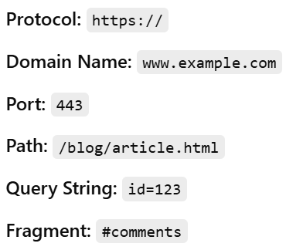
Uniform Resource Locator
A URL (Uniform Resource Locator) is the address used to access resources on the internet, such as web pages, files, and images. It serves as a reference to a specific location on the web.
https://www.example.com:443/blog/article.html?id=123

Slide 60
Domain Name Servers- The Internet's Phonebook
A Domain Name Server (DNS) is a system that translates human-readable domain names (e.g., www.google.com) into IP addresses (e.g., 142.250.183.206), which computers use to locate and communicate with each other over the internet.

Slide 61
Domain Name Servers
How DNS Works:
User Request:
You enter www.google.com in your web browser.
DNS Query:
Your computer asks a DNS server to find the IP address of www.google.com.
DNS Resolution:
If the DNS server doesn’t have the answer, it asks other servers in the DNS hierarchy.
IP Address Returned:
The DNS server returns the IP address (e.g., 142.250.183.206).
Website Loaded:
Your browser connects to 142.250.183.206 to load Google’s website.

Slide 62
Web Browsers – The Gateway to the Internet
A web browser is a software application that allows users to access and interact with websites by retrieving, rendering, and displaying web content from the internet.

Slide 63
Web Browsers – The Gateway to the Internet
How Web Browsers Work:
User Request:You enter a URL (e.g., https://www.google.com) or click a link.
DNS Resolution: The browser queries the Domain Name System (DNS) to get the website's IP address.
HTTP/HTTPS Request: The browser sends a request to the web server using the HTTP or HTTPS protocol.
Server Response: The web server returns HTML, CSS, JavaScript, and other assets.
Rendering: The browser processes and displays the webpage using its rendering engine.
User Interaction: You can scroll, click links, submit forms, and interact with the page.

Slide 64
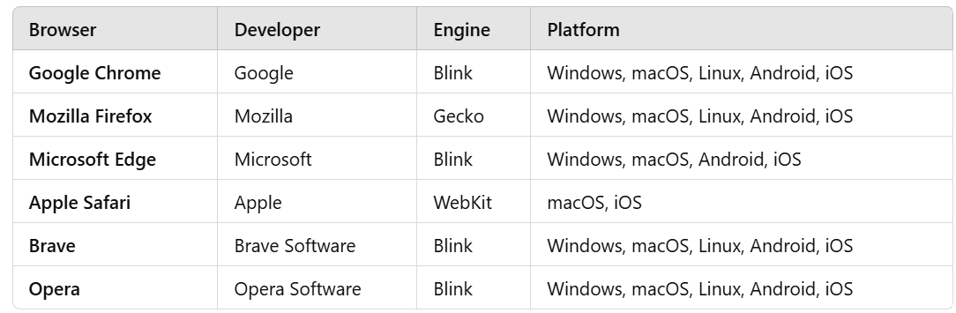
Web Browsers – The Gateway to the Internet
Popular Web Browsers:

Slide 65
Search Engine – The Internet’s Information Finder
A search engine is a software system that helps users find information on the internet by indexing, ranking, and retrieving web pages based on user queries.
Examples include Google, Bing, DuckDuckGo, and Yahoo.

Slide 66
Search Engine
How a Search Engine Works:
Crawling: Search engine bots (crawlers/spiders) scan websites and gather data.
Indexing:
The collected data is stored in a massive database called an index.
Helps search engines retrieve relevant results quickly.
Ranking:
When a user enters a search query, the search engine ranks results based on algorithms.
Displaying Results:
The search engine presents the most relevant links, often with descriptions, images, and ads.

Slide 67
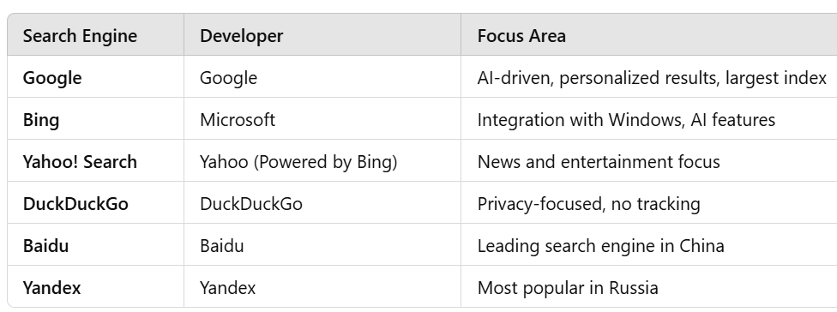
Search Engine
Popular Search Engines:

Slide 68
Web Server vs Application Server
A Web Server is responsible for handling HTTP requests from clients (browsers) and serving static content (HTML, CSS, JavaScript, images, videos, etc.).
🔹 Purpose: Serves web pages and static content. 🔹 Handles:
Static files (HTML, CSS, JS, images)
HTTP requests and responses
Best for: ✔️ Static websites ✔️ Content delivery (CDN) ✔️ Load balancing

Slide 69
Web Server vs Application Server
An Application Server runs business logic and generates dynamic responses for web applications by executing server-side code.
🔹 Purpose: Processes business logic and serves dynamic content. 🔹 Handles:
Backend logic (database interactions, authentication)
API requests (REST, SOAP)
Server-side scripting (Java, Python, PHP, Node.js)

Slide 70
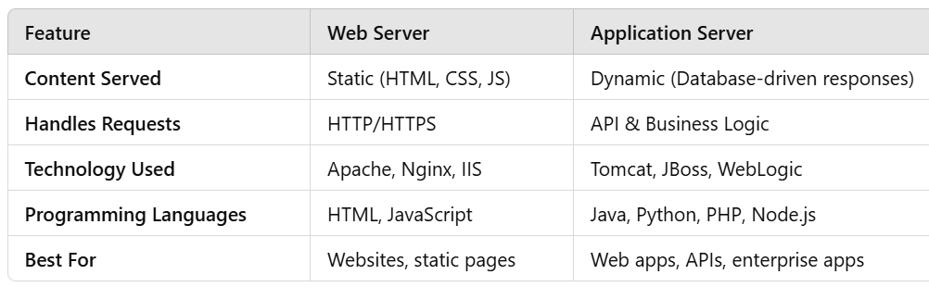
Web Server vs Application Server
Web Server vs Application Server – Comparison

Slide 71
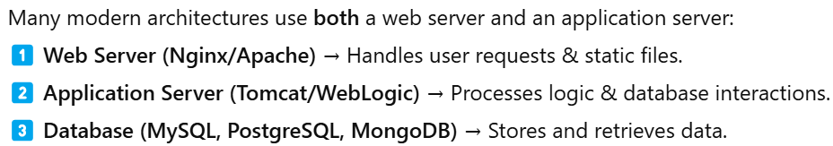
Web Server vs Application Server
How They Work Together

